Slide 1

CISC360 Computer Architecture
Lesson 0
Introduction

Slide 2
Schedule
Introduction
Syllabus
Introduction to Computer Architecture

Slide 3
Introduction
John K. Scoggin, Jr.
Systems Engineering Consultant
Conectiv, Inc.
Phone: (302) 451-5000 (Conectiv)
(302) 831-1028 (UDel)
Email: scoggin@cis.udel.edu

Slide 4

Office Hours
1:00 – 1:45 PM Tuesday and Thursday
Smith 101B
Other hours by appointment
Can sometimes be found on campus during the weekend; call/email first!

Slide 5
Syllabus
Electronic copy is available on the class website:
http://www.cis.udel.edu/~scoggin
(or http://clueless.cis.udel.edu)

Slide 6
What You Will Learn
LOTS of terminology (TLA/ETLA)
Basics of computer architecture
Impact on compiler & OS design
Intro to Computer Systems Design
How to build fast systems
Computer performance measurement

Slide 7


What’s with the Owl?
Important points
You will see this material again

Slide 8

What is Computer Architecture?
Interfaces
Technology
Machine
Organization
Applications
Measurement &
Simulation

Slide 9
Interfaces?
Between layers
  API
  ISA
Between modules or systems
  Network protocols, Channels/busses
Representations
  Character codes (ASCII/EBCDIC/6-bit)
  Numerics (IEEE 754)

Slide 10
Architecture & Organization 1
Architecture is those attributes visible to the programmer
  Instruction set, number of bits used for data representation, I/O mechanisms, addressing techniques.
  e.g. Is there a multiply instruction?
Organization is how features are implemented
  Control signals, interfaces, memory technology.
  e.g. Is there a hardware multiply unit or is it done by repeated addition?

Slide 11
Architecture & Organization 2
All Intel x86 family share the same basic architecture
The IBM System/370 family share the same basic architecture
This gives code compatibility
  At least backwards
Organization differs between different versions

Slide 12
Structure & Function
Structure is the way in which components relate to each other
Function is the operation of individual components as part of the structure

Slide 13
Hardware/Software Interface
Support OS functions
  Especially memory, I/O functions
Good compiler target
  Simple
  Orthogonal
Efficient hardware implementation
Effective parallelism

Slide 14
System-level Decisions
Design at CPU, memory and interconnect level
Important to application performance
Speeds constrained by
  IC pin count
  Module connector pin count
  Signaling rates
Application-specific

Slide 15
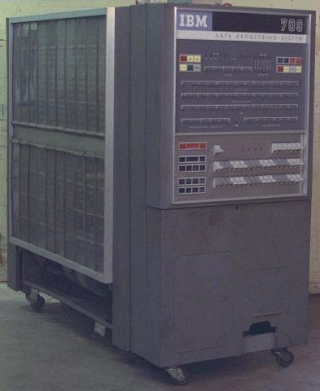
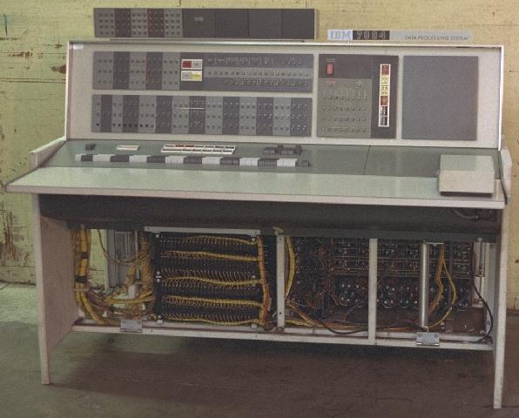
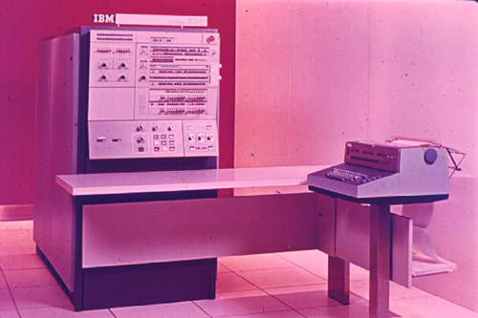
System Level Decisions
Driven by
  Cost/performance goals
  Available component technology
  Technology constraints
  Backwards compatibility needs (709-7090-360)

Slide 16
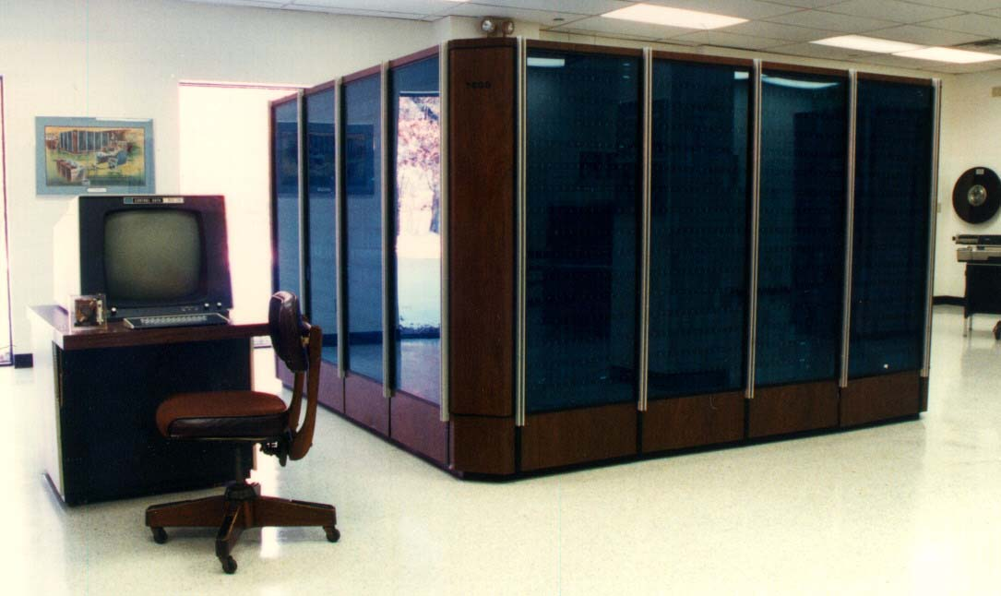
Computer System Performance
CPU execution time
  FP arithmetic
  Integer arithmetic
  Branches/procedure calls
Main memory bandwidth
I/O performance
  Transfer bandwidth
  Latency
  Polygons/pixels per sec.
CDC 7600

Slide 17
Function
All computer functions are:
  Data processing
  Data storage
  Data movement
  Control

Slide 18
Functional view
Data
Storage
Facility
Data
Movement
Apparatus
Control
Mechanism
Data
Processing
Facility

Slide 19

Operations (1) Data movement

Slide 20
Operations (2) Storage

Slide 21
Operation (3) Processing from/to storage

Slide 22
Operation (4)
Processing from storage to I/O

Slide 23
Structure - Top Level
Peripherals
Computer
Central
Processing
Unit
Main
Memory
Computer
Systems
Interconnection
Input
Output
Communications
lines

Slide 24
Structure - The CPU
CPU
Computer
Arithmetic
and
Logic Unit
I/O
Registers
System
Bus
CPU
Internal CPU
Interconnection
Memory
Control
Unit

Slide 25
Structure - The Control Unit
Control Unit
CPU
ALU
Sequencing
Logic
Internal
Bus
Control
Unit
Control Unit
Registers and
Decoders
Registers
Control
Memory

